Slide 1

PRAJWAL.B
09-0-2024
Hotel Management Analysis
:-
(Data Analyst)

Slide 2




Prajwal
About the Company
Prajwal Groups is a prominent player in the hotel business, operating seven hotels under its banner. Known for its commitments to hospitality excellence,.
Started in 1995
Our people
Executive Team
With 2500+
employees
Why we started
Passion for Hospitality
Market Opportunity
Vision for Growth
Groups

Slide 3
Problem
Statement
The hotel industry faces various challenges in efficiently managing operations, including reservations, room occupancy, and guest services. These challenges include optimizing revenue generation by effectively utilizing room inventory, check-in/check-out processes, and adapting demand patterns. enhance guest satisfaction, and maximize profitability in a competitive market environment

Slide 4

DATABASE :>
PRAJWAL
--------- TABLES ----------
Bookings
Booking info
Dim date
dim hotels
dim rooms

Slide 5

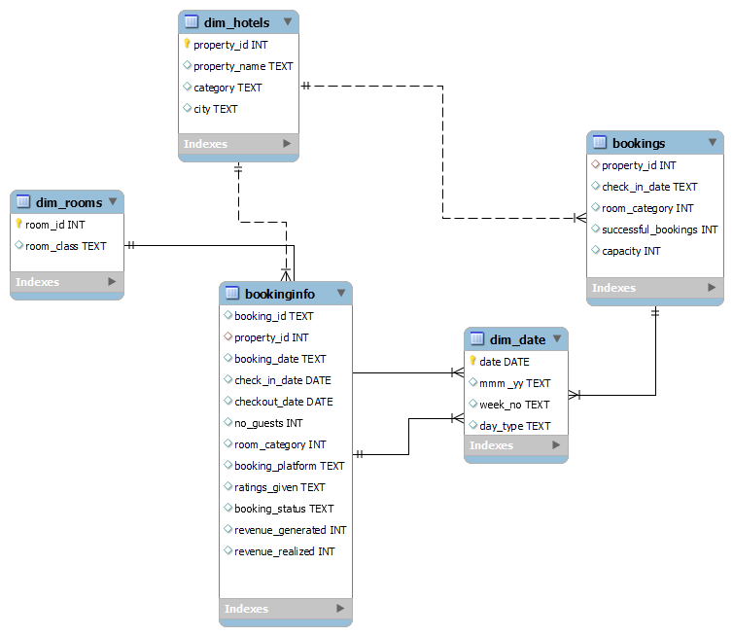
schema

Slide 6

RETRIVING DATA FROM DIFFERENT TABLES
PRAJWAL
BY QUERY
Bookings
Booking info
Dim date
dim hotels
dim rooms
three million five hundred forty-four thousand three hundred fifty-eight.

Slide 7

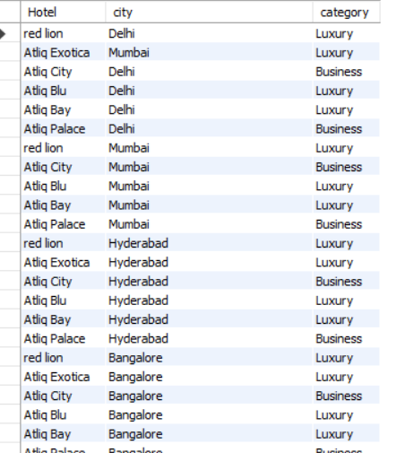
1 :
How many properties are there, in how many cities has the business been established, and how many categories are available?
select count(distinct property_name) Hotel ,count(distinct city) city,count(distinct category) category from dim_hotels;
2 :Display property_name,city,category
SELECT DISTINCT property_name AS Hotel, city, category
FROM dim_hotels;

Slide 8

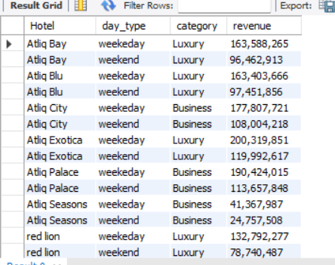
3. What is total revenue generated prajwal group’s
select FORMAT(sum(revenue_realized),0)
from bookinginfo;
4. Display the Total revenue and Segregate revenue by hotel names, distinguishing between
weekdays and weekends, and it’s Category
select h.property_name as Hotel ,d.day_type, h.category,format(sum(b.revenue_realized),0) as revenue from dim_hotels as h inner join bookinginfo as b on b.property_id=h.property_id inner join dim_date as d on b.check_in_date=d.date group by property_name,category,day_type order by property_name;

Slide 9
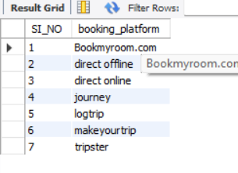
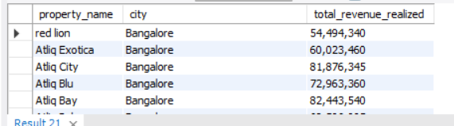
5. Which booking platform supports hotel room reservations for Prajwal Groups and How many Online platform?
SELECT ROW_NUMBER() OVER (ORDER BY booking_platform) AS SI_NO, booking_platform FROM (SELECT DISTINCT booking_platform FROM bookinginfo) AS distinct_booking_platforms;
6. What is the total revenue generated city-wise and for each property ?
SELECT dh.property_name, dh.city, FORMAT(SUM(bi.revenue_realized), 0) AS total_revenue_realized FROM
dim_hotels dh INNER JOIN bookinginfo bi ON dh.property_id = bi.property_id
GROUP BY dh.property_name, dh.city
ORDER BY dh.city;

Slide 10
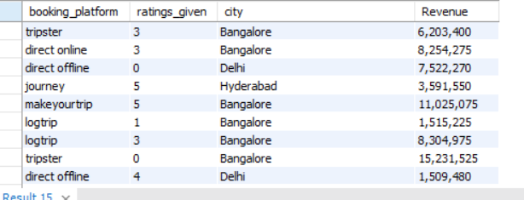
7. Find the revenue generated by an online platform and the customer ratings given to that Hotels, categorized by city. This analysis will help the manager make informed decisions about allocating funds to different online platforms.
SELECT
distinct booking_platform,
avg(ratings_given), h.city,
FORMAT(SUM(revenue_realized), 0) AS Revenue
FROM bookinginfo inner join dim_hotels as h on bookinginfo.property_id = h.property_id
GROUP BY booking_platform, ratings_given,city;

Slide 11
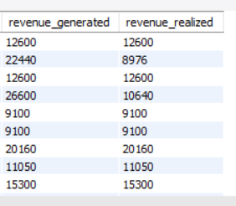
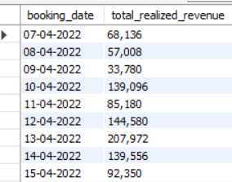
8. Calculate the profit for each day , considering that 75% of the booking amount is refunded upon cancellation, and the remaining 25% is considered as profit for the hotel.
ex : payed amount is 10,000 ,if they cancel ,hotel will refund
75% means 7,500 and remain 25% will be profit to the hotel or prajwal groups
SELECT booking_date, FORMAT(SUM(revenue_realized), 0) AS total_realized_revenue FROM bookinginfo
WHERE revenue_generated <> revenue_realized
GROUP BY booking_date;
Ex:22440-8976= 13,464 (Profit=8976)

Slide 12

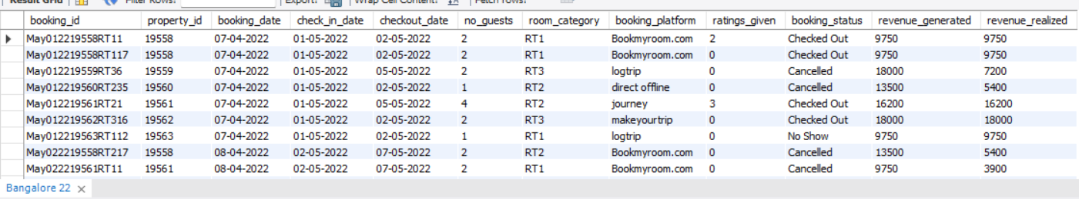
9. From Last 3 months ,How may Customers stayed in there hotels (3 MONTHS DATA WE HAVE)
select count(distinct check_in_date) as days ,
format(count(no_guests),0) as Guests
from bookinginfo;
10 . Retrieve information on the business performance in various cities to update company employees

Slide 13
create view Bangalore as SELECT *FROM bookinginfoWHERE property_id = ANY (SELECT property_id
FROM dim_hotels WHERE city = 'Bangalore’);
select * from Bangalore;
create view Delhi as SELECT *FROM bookinginfoWHERE property_id = ANY (SELECT property_id
FROM dim_hotels WHERE city = 'Delhi’);
select * from Delhi;
create view Hyderabad as SELECT *FROM bookinginfo WHERE property_id = ANY (SELECT property_id FROM dim_hotels WHERE city = 'Hyderabad’);
select * from Hyderabad;
create view Mumbai asSELECT *FROM bookinginfoWHERE property_id = ANY (SELECT property_id FROM dim_hotels WHERE city = 'Mumbai’);
select * from Mumbai;

Slide 14
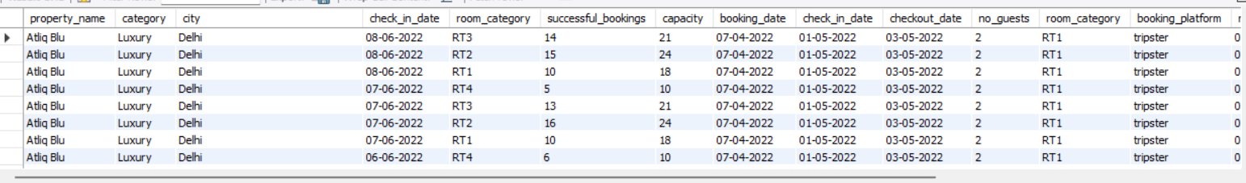
11. Manager want to see all details of online Platform Performance
delimiter //
create procedure details_on_Booking_Platform( in BP varchar(30))begin
select h.property_name,h.category,h.city,b.check_in_date,b.room_category,b.successful_bookings,b.capacity ,bb.booking_date,bb.check_in_date,bb.checkout_date,bb.no_guests,bb.room_category,bb.booking_platform,bb.ratings_given,bb.booking_status,bb.revenue_generated,bb.revenue_realizedfrom dim_hotels as h
inner join bookings as b on h.property_id=b.property_id inner join bookinginfo as bb on h.property_id=bb.property_id where bb.booking_platform = BP;
end; //
call details_on_Booking_Platform('tripster’);
# Bookmyroom.com and makeyourtrip,

Slide 15

11. Updating the Room Availability
delimiter //
create procedure updatedate(in newdata int,in olddata int)begin
update dim_hotels set Capacity=newdata where property_name =olddata;
end;//
call update_hotels(30,25);
12. Manage the hotel room capacity if they entry (-) room capacity and the hotel room capacity is only 30 ,if they enter more than 30 ,it should automatically update 30 rooms
delimiter //
create trigger cheakcapacitybefore insert on bookingsfor each rowbeginif new.capacity <=0 and new.capacity >30 then set new.capacity=30;end if;
end//
INSERT INTO bookings (property_id, check_in_date, room_category, successful_bookings, capacity)VALUES (101, '2022-01-05', 'RT1', 25, -30);

Slide 16
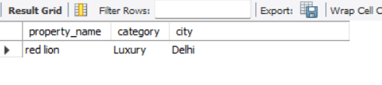
13. Finding the Booking Details by Bookingid
delimiter //
create procedure find_my_loc(in find varchar(50))beginselect property_name,category,city from dim_hotels where property_id=(select property_id from bookinginfo where booking_id = find);
end; //
call find_my_loc("May012216558RT21");

Slide 17
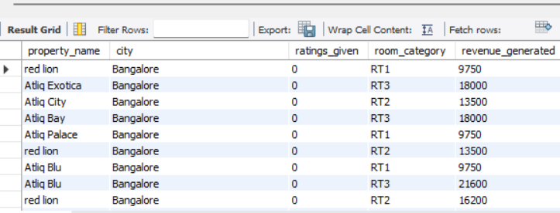
14. Managers can assess how customers rate their hotels by assigning a rating number between 0 and 5
delimiter //
create procedure find_hotel(in rating int,in city1 varchar(20))begin
select h.property_name,h.city,b.ratings_given,b.room_category
from dim_hotels as h inner join bookinginfo as b on h.property_id =b.property_id
where ratings_given= rating and city =city1;
end; //
call find_hotel(0,"Bangalore");

Slide 18
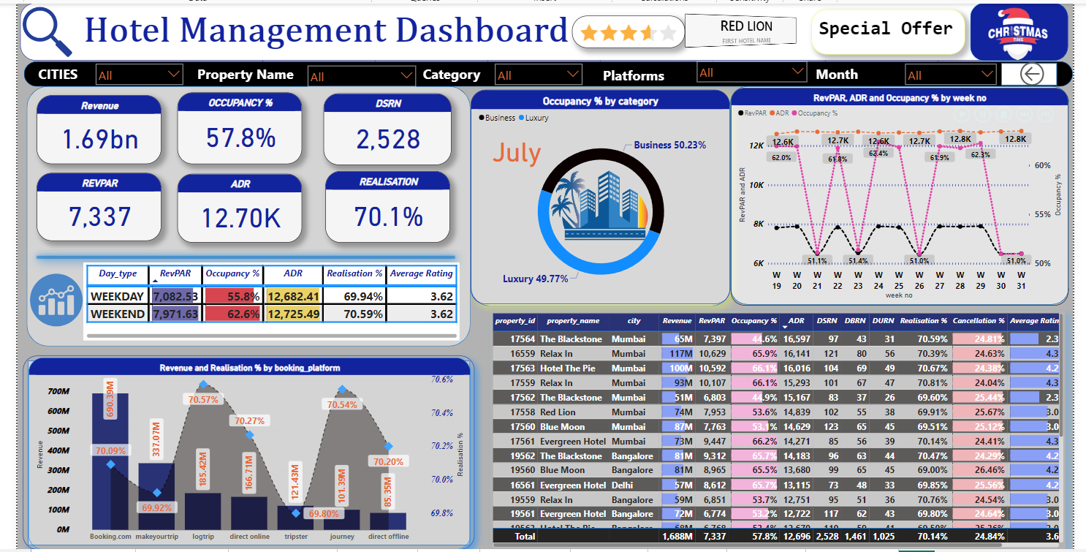
Over All View

Slide 19

Thank you
Prajwal B (Data Analyst)
I truly value your input and suggestions. Your ideas and advice play a crucial role in my growth and development as a data analyst. I'm eger to collaborating on future projects, especially those focusing on specific domains. I believe that teamwork leads to superior outcomes, and with your continued support, I'm confident we can achieve great success together. Thank you for Valuable Time.
Linked in
linkedin.com/in/prajwal10da
Github
https://github.com/PrajwalDataAnalyst

